Slide 1
The film I’ll never forget…
Prepared by:
Wojciech Koziołek
IIIa

Slide 2
The film I’ll never forget is
,,Marie Antoiniette,,
written and directed by Sofia Coppola.

Slide 3
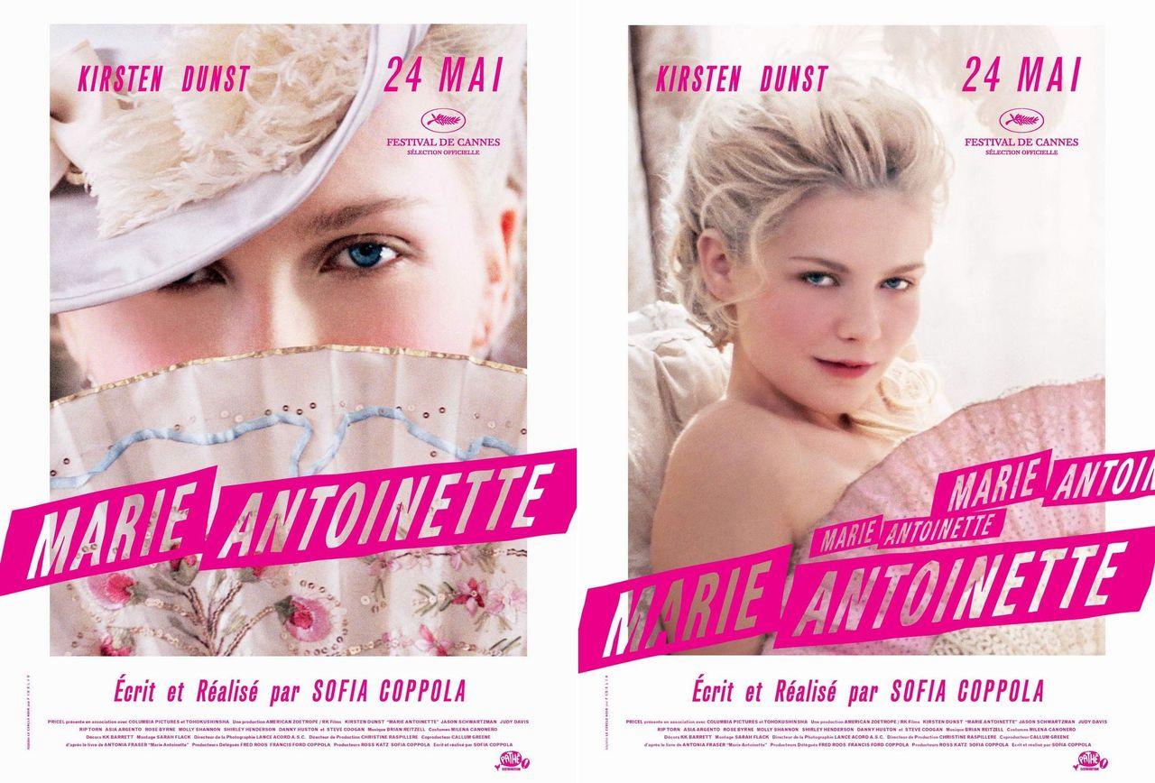
Marie Antoinette movie posters.

Slide 4
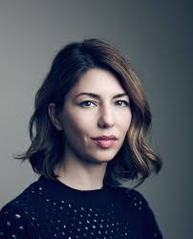
A few words about the director…
Sofia Coppola (born 14 May, 1971) is an American screenwriter, director and producer.
Sofia Coppola

Slide 5
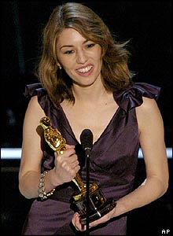
Coppola is one of the best American directors. In 2003, she received the Academy Award for Best Original Screenplay for ,,Lost in Translation,,.

Slide 6
,Marie Antoinette,, was her third film.
It debuted at the 2006 Cannes Film Festival where it received a standing ovation. Critics were divided.

Slide 7
About the film
,,Marie Antoinette,, is a 2006 historical comedy-drama film, written and directed by Sofia Coppola. It is based on the life of the Queen in the years leading up to the French Revolution.
,,Marie Antoinette,, won an Academy Award for Best Costume Design.

Slide 9
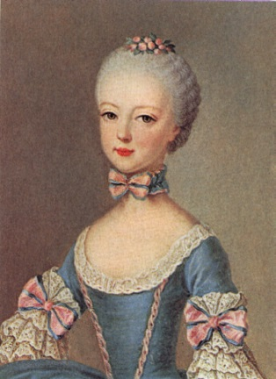
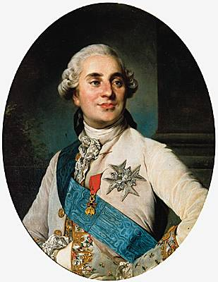
Plot
Fourteen-year-old Maria Antonia Habsburg- better known as Marie Antoinette (Kirsten Dunst in this role) is the beautiful and charming princess of Austria, and the youngest daughter of Empress Maria Theresa's sixteen children. In 1768, she is selected by her mother to marry the Dauphin of France, the future Louis XVI of France (Jason Schwartzman in this role), therefore sealing an alliance between the two rival countries.

Slide 10
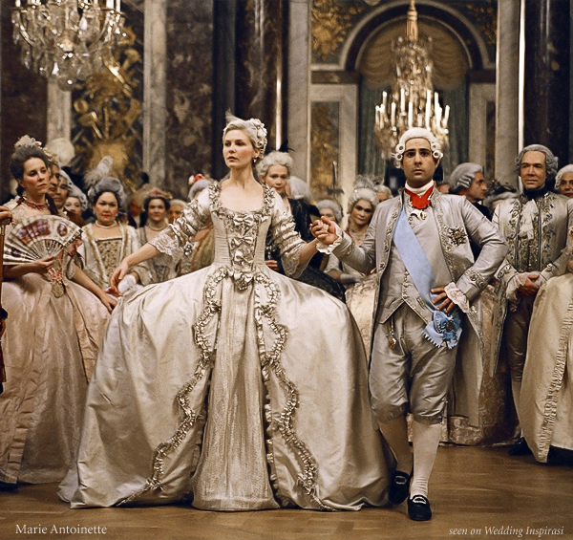
Marie Antoinette and the Dauphin of France wedding scene.

Slide 11
After official meeting Marie Antoinette and her fiance arrive at the palace of Versailles and are married. Then they are encouraged to procreate an heir to the throne as soon as it is possible. Unfortunately young princess has problem with getting pregnant. Her husband's courtiers disdain her as a foreigner, and constantly blame her for not having procreated an heir. The French court is rife with gossip…

Slide 12
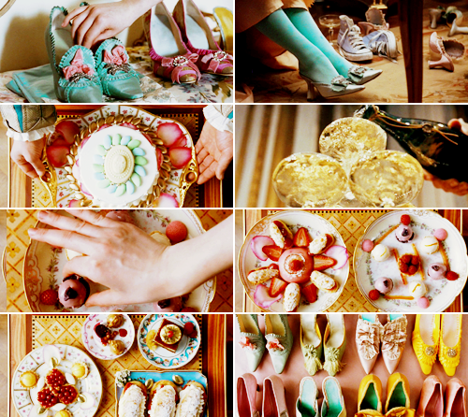
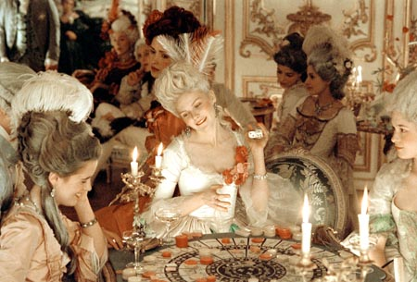
To have a better mood Marie spends most of her time buying shoes, dresses, jewelry, luxurious pastries. She also spends money for gambling and parties.

Slide 14
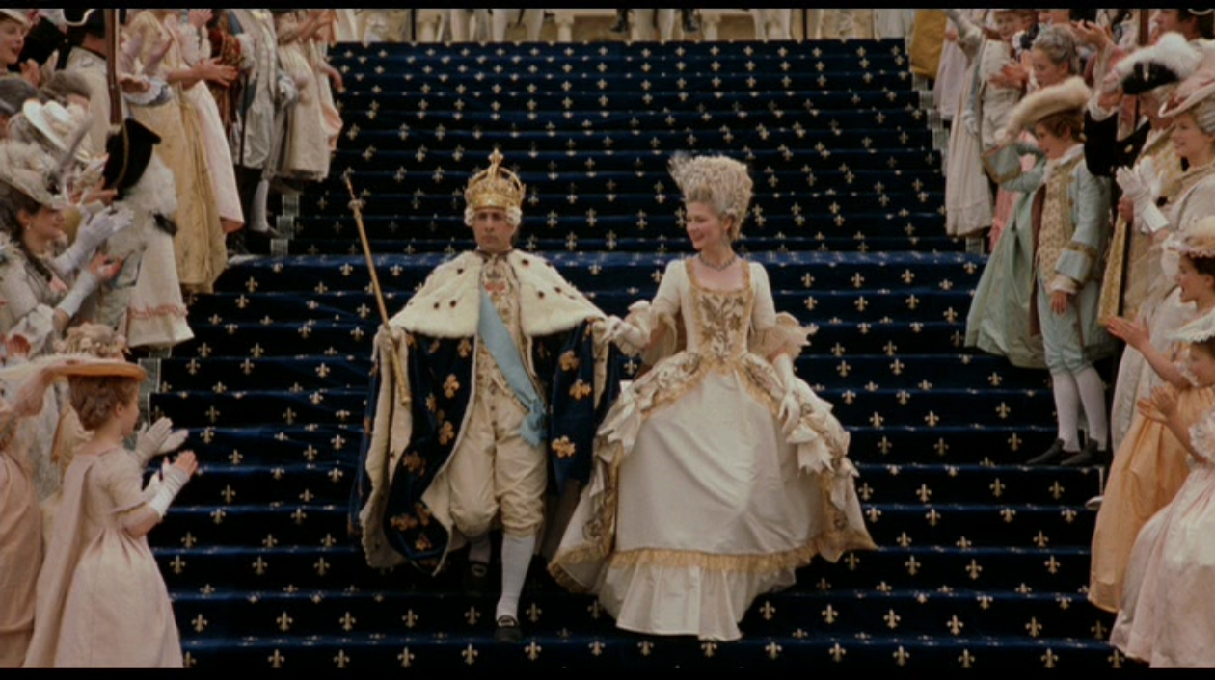
At the age of 19 Marie Antoinette became a Queen of France.

Slide 15
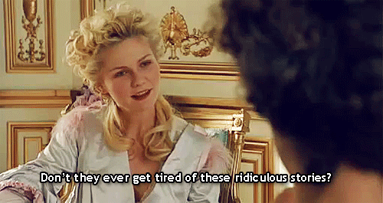
Finally she gives birth to a daughter and she begins an affair with earl Axel von Fersen. She also gives birth to son and another daughter, Princess Sophie of France who unfortunately dies. Queen’s luxurious and sumptuous life becomes the object of gossip.

Slide 16
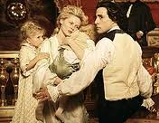
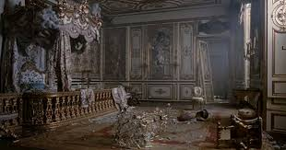
As the French Revolution begins to erupt rapidly, the royal family resolves to stay in France, unlike much of the nobility. Angry rioting Parisians force the family to leave Versailles for Paris.
The film ends with the royal family's transfer to palace in Paris. The last image is a shot of Marie Antoinette's bedroom, destroyed by angry rioters.

Slide 17
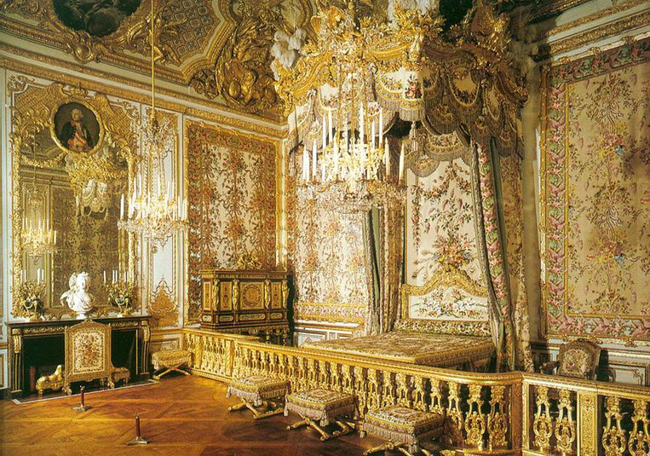
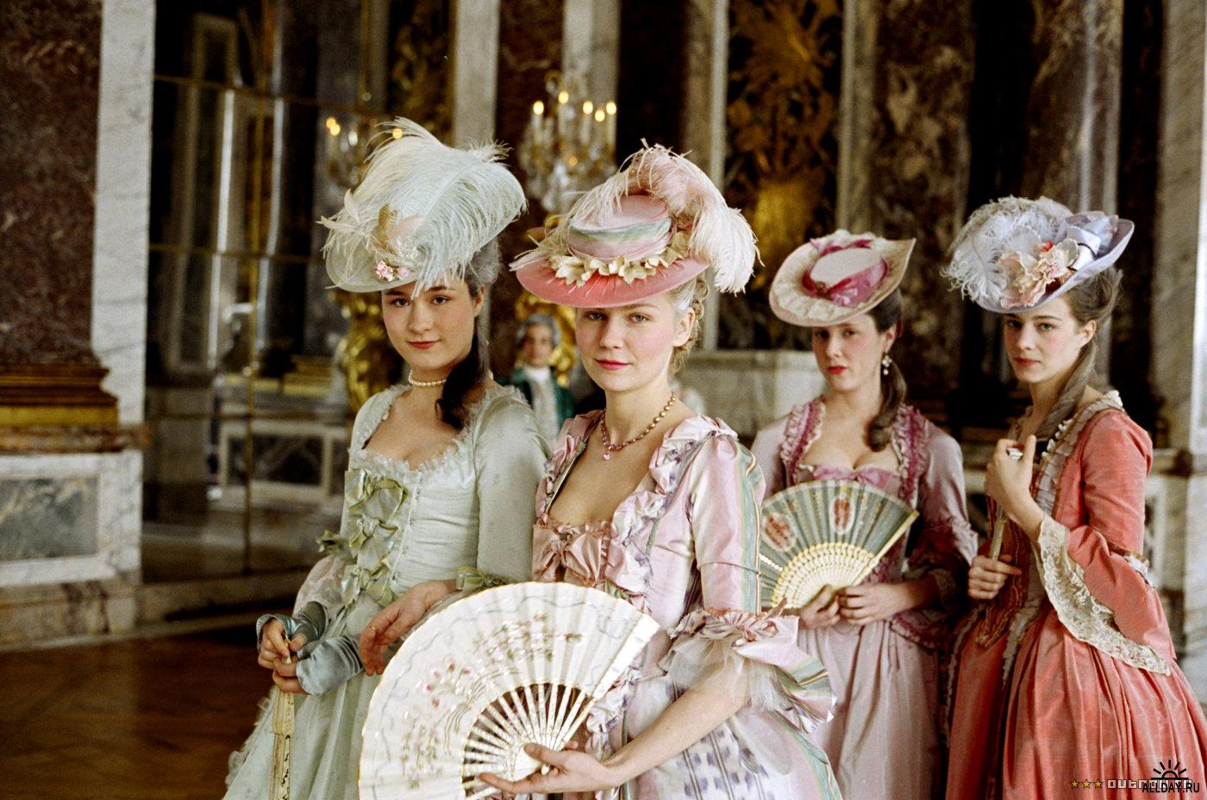
Why I like this movie so much?
I love this movie for several reasons. One of them is that I think it is a visually beautiful film. Look at this costumes and palace interiors! Aren’t they amazing?

Slide 18
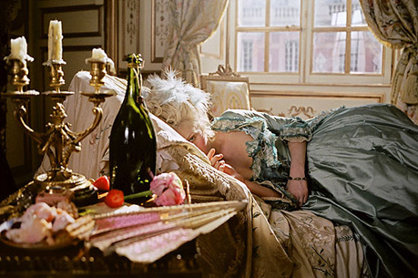
I think that music which was used in this film is also very beautiful. The film is very artistic and for me it is perfect in every way. It is touching, instructive and funny at the same time. I love the way Marie Antoinette’s life has been shown in this film. She is portrayed as a teenager who wants to have fun and live in her own way. Like we all.
The movie is not boring, even if you don’t like the historical movies. That's why I can recommend this movie to everyone.

Slide 19
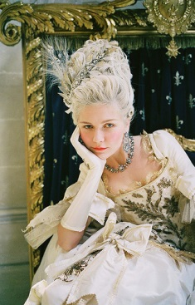
Thank you for watching.

Slide 20
Bibliography
http://en.wikipedia.org/wiki/Marie_Antoinette_(2006_film)
http://en.wikipedia.org/wiki/Sofia_Coppola
http://www.imdb.com/title/tt0422720/
http://1.bp.blogspot.com/_HBJaKhkvNsA/TTWWQhYj9fI/AAAAAAAAAGI/5LEbrcezDok/s1600/mar.jpg
http://www.bing.com/translator
http://farm3.staticflickr.com/2775/4387085864_cba9d739b0.jpg
http://eu.movieposter.com/posters/archive/main/41/MPW-20679

